Slide 1
进度汇报
2018.11
——张玮雯

Slide 2
Dual Attention Network for Scene Segmentation
83.08/96.4 | 95.17 | 79.54 | 85.01 | 94.67 | 92.68 | 71.38 | 97.72 | 82.74 | 92.7 | 62.25 | 79.15 | 65.07 | 81.89
finetune | car | bicycle | person | sky | plant | traffic light | road | sidewalk | building | fence | sign | pole | bus
60.86/90.47 | 89.26 | 37.01 | 49.39 | 82.2 | 82.47 | 42.81 | 94.68 | 50.02 | 70.51 | 52.25 | 28.39 | 44.54 | 67.66
41.85/78.05 | 41.47 | 28.91 | 56.57 | 85.34 | 74.88 | 28.23 | 7552 | 39.19 | 68.07 | 13.95 | 0.97 | 15.22 | 15.77
61.3/91.43 | 88.62 | 44.07 | 60.94 | 90.19 | 85.15 | 38.31 | 95.13 | 56.01 | 75.16 | 53.15 | 32.48 | 40.86 | 36.83
train
58.44 | 87.93 | 33.04 | 47.39 | 77.48 | 80.75 | 41.92 | 94.76 | 52.39 | 67.27 | 49.85 | 32.3 | 39.68 | 54.96
40.02 | 31.89 | 22.37 | 50.19 | 83.36 | 77.25 | 33.33 | 53.36 | 29.01 | 67.88 | 7..81 | 2.92 | 15.06 | 45.84

Slide 3
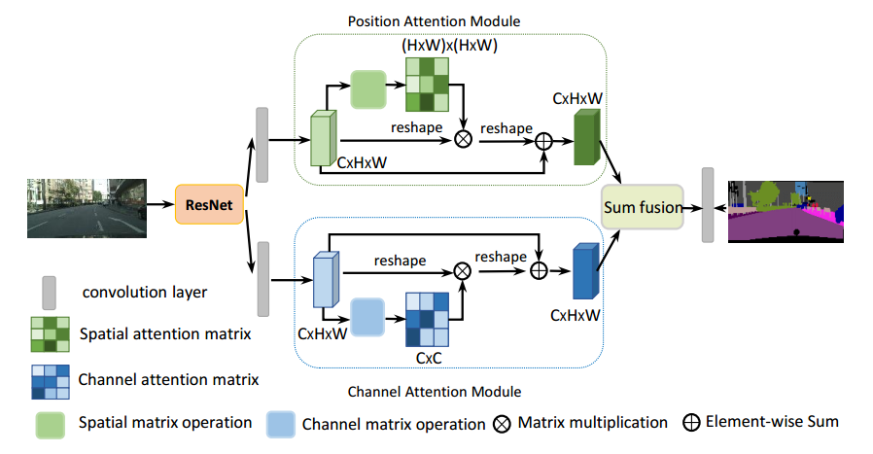
VS
ResNet101
cov
＋
MPAM
cov
IR
ResNet101
＋
cov
＋
MCAM

Slide 4
